Slide 1

Cloud Computing and Big Data Analytics Project
Dataset – Loan Approval
Instructor:
Group no 7:
Instructor: Mahnaz Nia
Presented By: Bindiya

Slide 2
Index
Introduction
Loan Dataset
Introduction
Description of Dataset
Problem Statement
Hypothesis
Objective of Analysis
Data Analysis
Model Building
Model Evaluation
Overfitting Analysis
Feature Importance
Conclusion

Slide 3
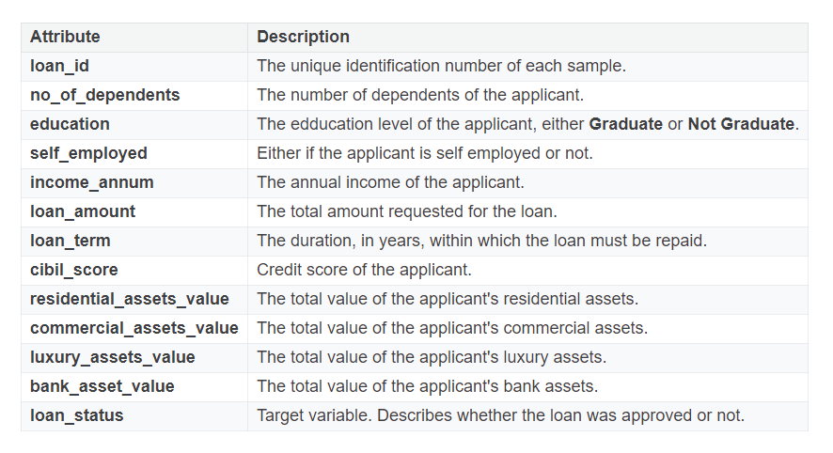
Loan Dataset
Introduction
The loan approval dataset is a collection of financial records and associated information used to determine the eligibility of individuals or organisations for obtaining loans from a institution. It includes various factors such as cibil score, income, employment status, loan term, loan amount, assets value, and loan status. The dataset is used in machine learning and data analysis to develop models and algorithms that predict the likelihood of the loan approval based on the features.
Description of Dataset: The dataset has 4269 observations and 13 variables

Slide 4
Problem Statement, Hypothesis and Objective
Problem Statement:
Dream Housing Finance company deals in all home loans. They have a presence across all urban, semi-urban, and rural areas. Customer-first applies for a home loan after that company validates the customer eligibility for a loan.
The company wants to automate the loan eligibility process (real-time) based on customer detail provided while filling the online application form. These details are Gender, Marital Status, Education, Number of Dependents, Income, Loan Amount, Credit History, and others.
To automate this process, they have given a problem to identify customers, those are eligible for loan amount so that they can specifically target these customers.
Hypothesis:
Automating the loan eligibility process using machine learning algorithms based on customer details will significantly improve the accuracy and efficiency of identifying eligible loan applicants for Dream Housing Finance Company.
Objective:
This Project tries to predict whether the loan will be approved for an individual or not on the basis of features such as cibil score, education level, annual income etc.

Slide 5
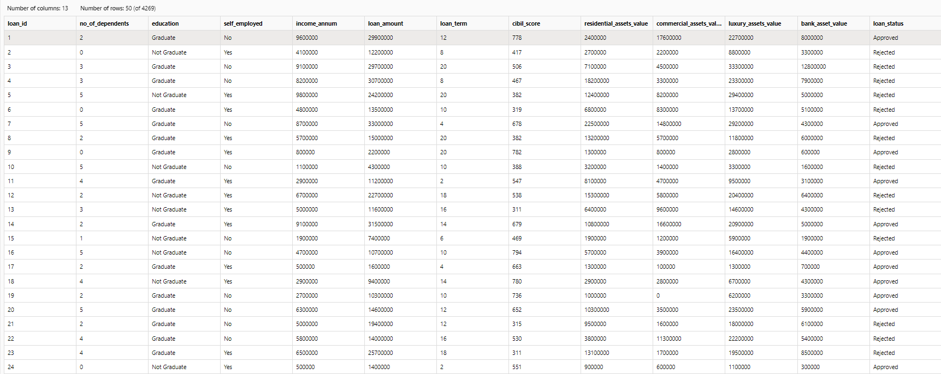
Dataset Imported in Azure Environment

Slide 6
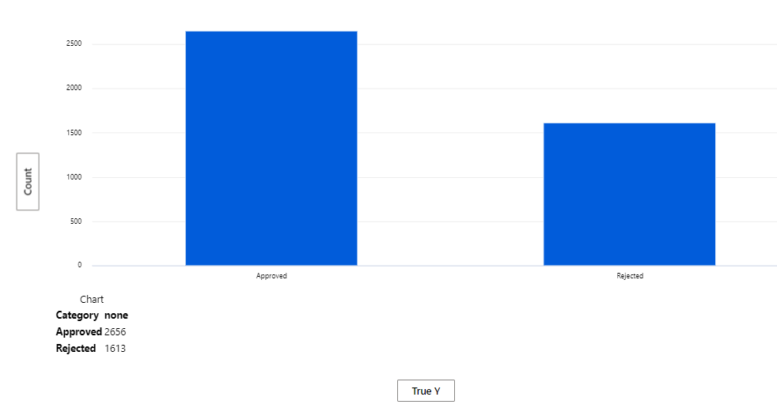
Data Analysis
Target Variable : Loan Status
Loan Request Approved: 62%
Loan Request Rejected: 38%

Slide 7
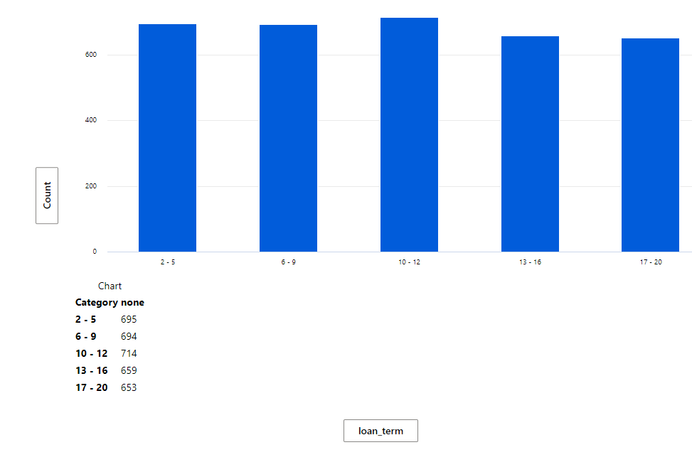
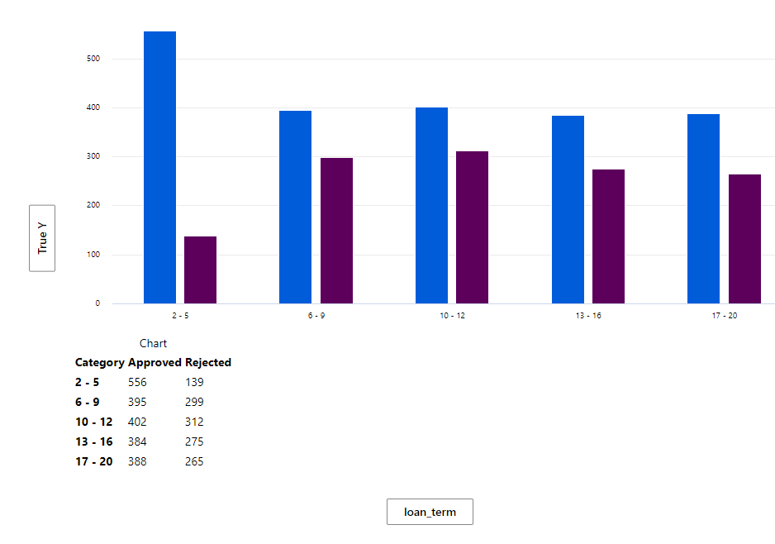
Data Analysis
Loan term v/s Loan Status
Approved
Rejected
Insight:
Maximum applicants has opted 10-12 years as a loan term, on further analysis we analysed that Maximum Applicants who had opted loan term of 2-5 years and 6-9 years got their loan approved as compared to all others categories.

Slide 8
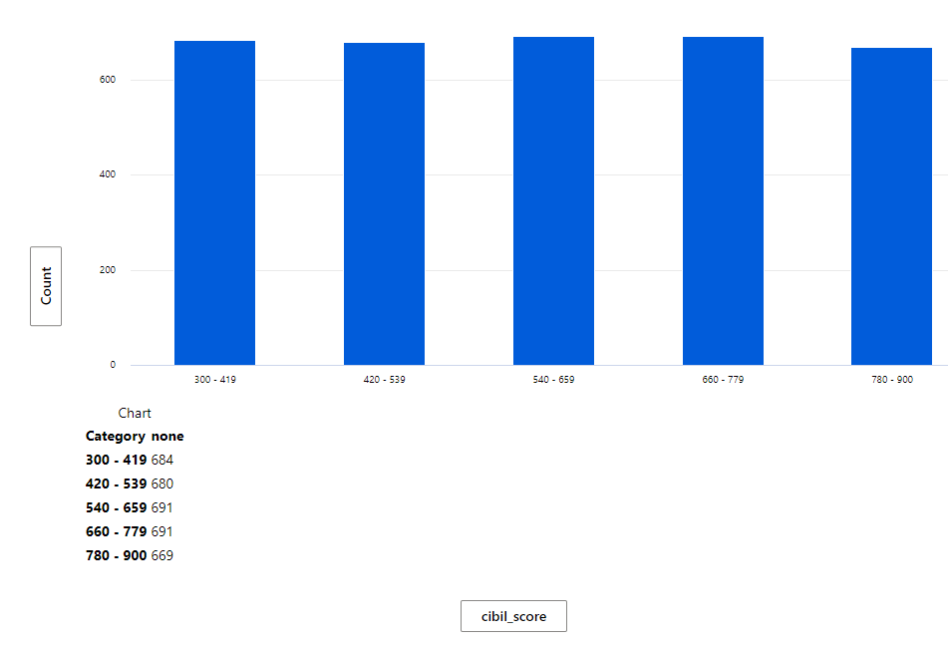
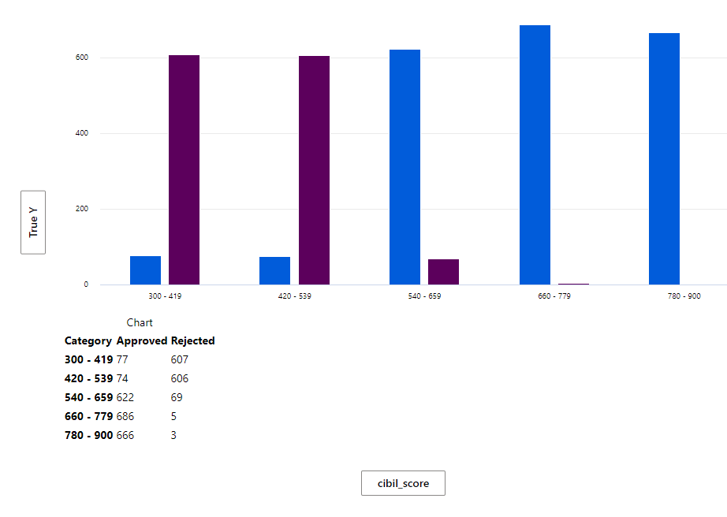
Data Analysis
Cibil Score v/s Loan Status
Approved
Rejected
All applicants equally fall in cibil score categories but on further analysis we found that , applicants having cibil score more than 540 have their loan application approved as compared to one with cibil score between 300 to 539. Cibil score is one of the most important factor to be considered.

Slide 9
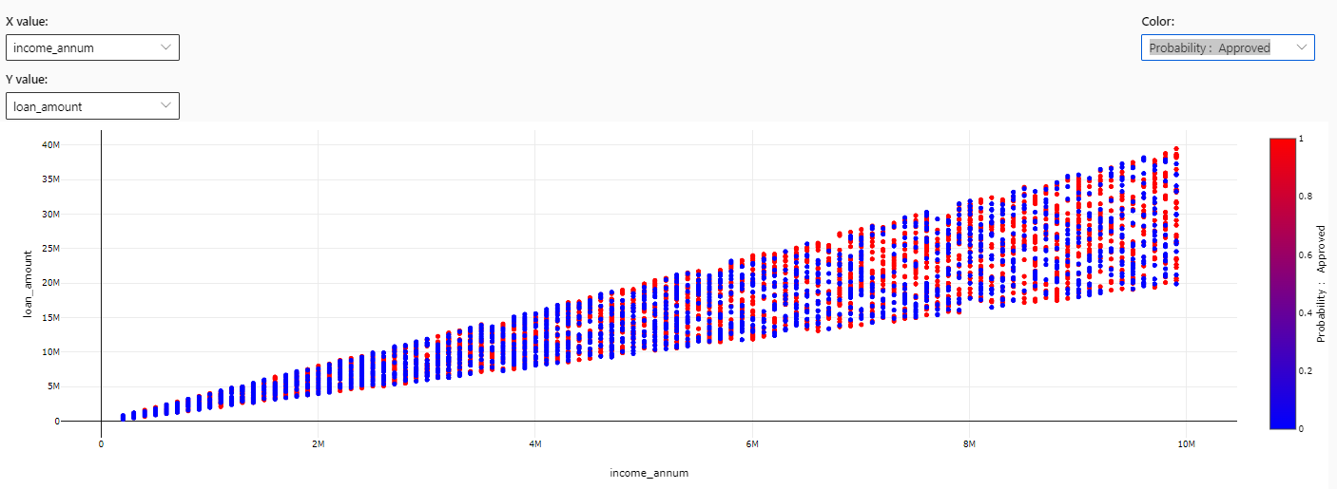
Data Analysis
Income v/s Loan Amount
High linear correlation between income of the applicants and loan amount applied for.

Slide 10
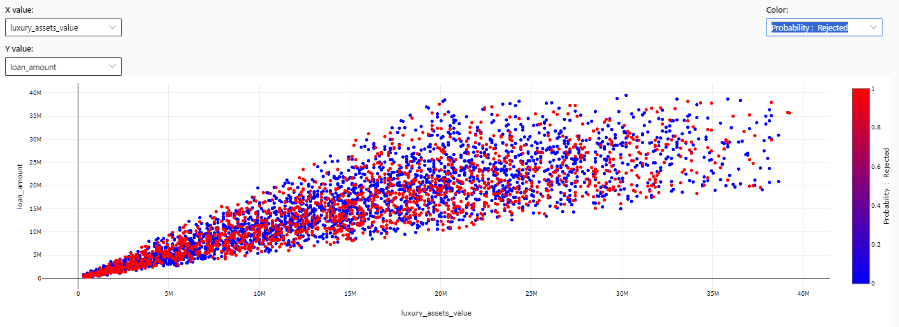
Data Analysis
Loan Amount v/s Luxury_assets_value
High linear correlation between luxury asset value of the applicants and the loan amount applied for

Slide 11
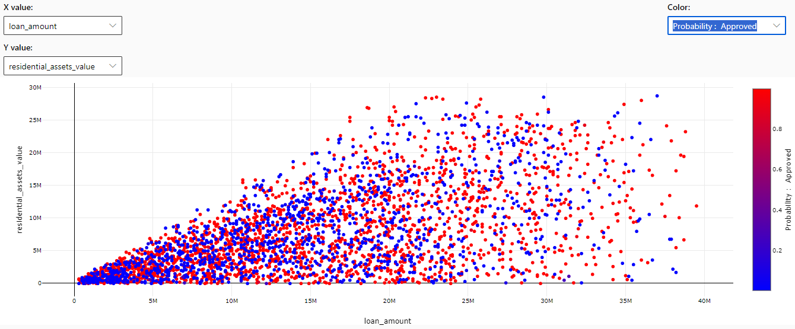
Data Analysis
Loan Amount v/s bank_asset_value
Moderate Linear Correlation between loan amount and residential_asset_value

Slide 12
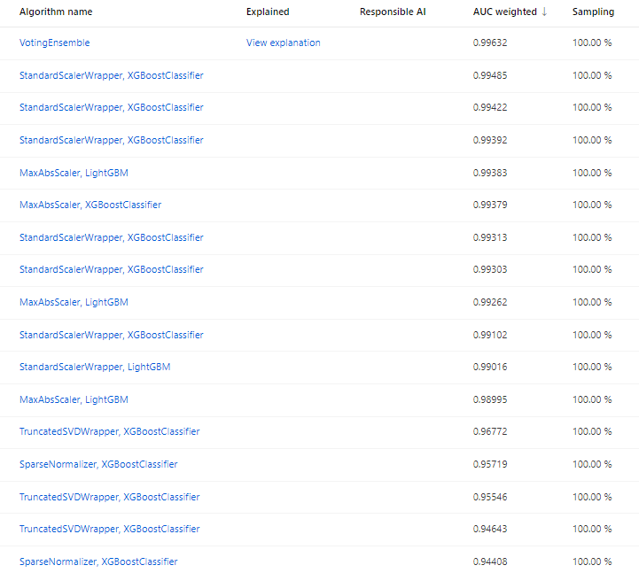
Model Building

Slide 13
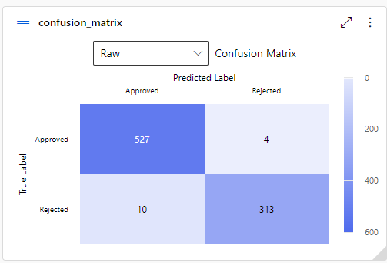
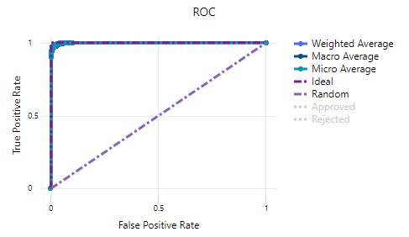
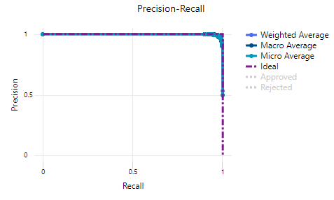
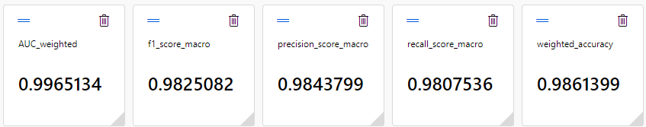
Model Evaluation
Automated ML -VotingEnsemble Model
Best Model Summary
Methodology: 60%-20%Train validation Split/20% Train test split

Slide 14
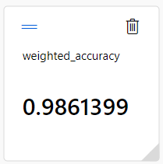
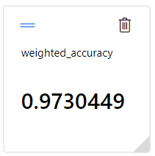
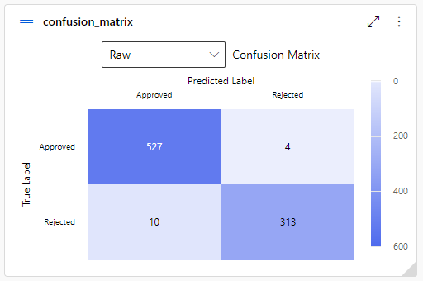
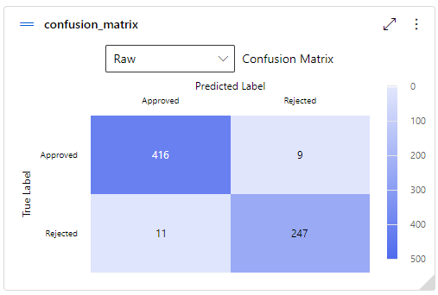
Overfitting Analysis
AutomatedML-VotingEnsemble Model
Test Dataset
Train-Validation Dataset

Slide 15
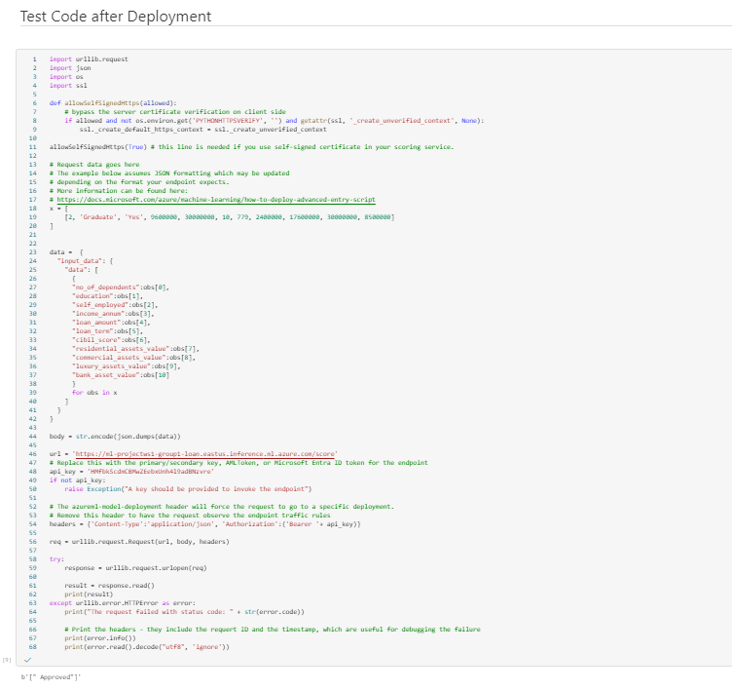
Testing Model with Dummy data

Slide 16
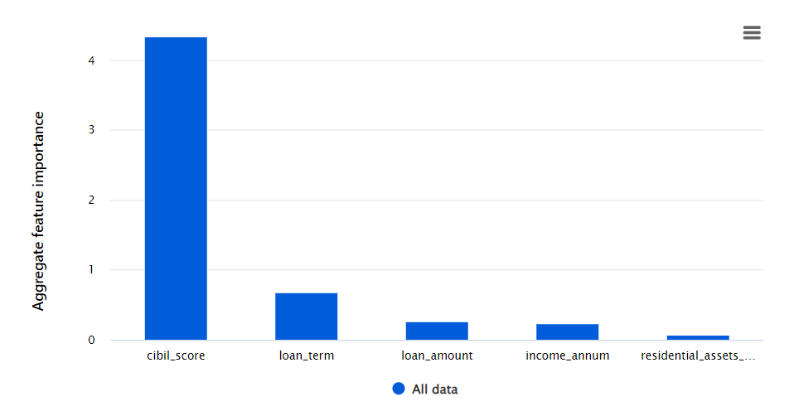
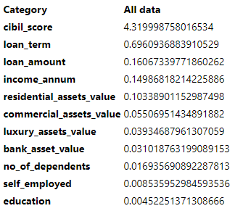
Feature Importance
AutomatedML-VotingEnsemble
Top 5 Features impacting Target variable :

Slide 17
Data Preprocessing Steps
Pipeline Model Building
Total 13 Variables
12 Variables selected
Removed Duplicate Rows
Cleaned Missing Data
2 Variables - One Hot Encoded
Normalised Data
Model built with 11 variables

Slide 18
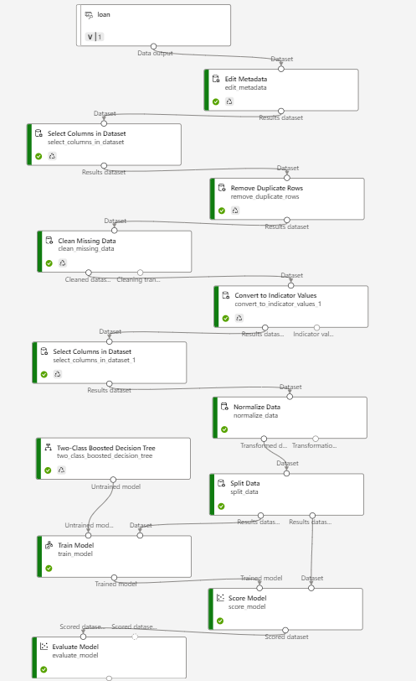
Analysis – Pipeline
Boosted Decision Tree Model :
Methodology :
70%-30% Train Test split

Slide 19
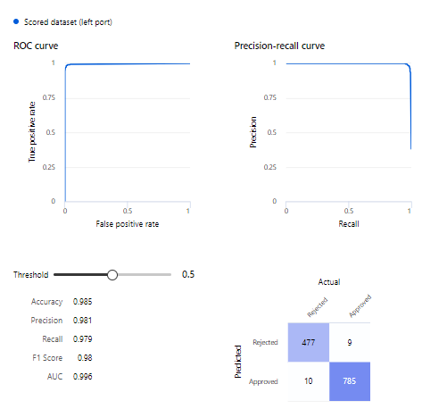
Model Evaluation
Pipeline - Boosted_Decision_Tree

Slide 20
Conclusion
CIBIL Score: The CIBIL score reflects the creditworthiness of the applicant and their repayment history. A higher score indicates lower risk, making it a crucial factor in the decision-making process
Applicants with higher CIBIL scores are more likely to have their loans approved due to lower associated risk
Loan Term: The duration of the loan term influences the repayment schedule and the overall risk exposure for the lender. Longer loan terms may indicate higher risk due to extended repayment periods
While not as critical as the CIBIL score, the loan term affects the decision, with shorter terms possibly being favored due to reduced risk
Loan Amount: The amount of the loan directly impacts the level of financial commitment and risk for both the borrower and the lender. Larger loan amounts carry higher risk
Loan amounts are a significant consideration, with smaller loans being potentially more favorable due to reduced risk exposure
Income per annum: The applicant's annual income is a key indicator of their ability to repay the loan. Higher incomes suggest greater repayment capacity and lower default risk
Applicants with higher annual incomes are more likely to have their loans approved, as they demonstrate the financial capability to meet repayment obligations
Residential Status: Residential assets serve as collateral and provide additional security for the lender. They indicate the applicant's financial stability and ability to mitigate risk
While not as crucial as income and credit score, residential assets play a significant role, particularly in securing larger loans or mitigating risk for borderline cases

Slide 21
Thank You

